Slide 1
AI-BASED VIOLENCE DETECTION AND ALERTING MANAGEMENT SYSTEM
TEAM MEMBERS
RAJENDRAPRASATH M
810022104104
GUIDED BY

Slide 2
INTRODUCTION
Public safety is a major concern in urban and industrial environments.
Manual monitoring of surveillance cameras:
Is time-consuming
Prone to human error
Delays emergency response
This project develops an AI-based violence detection system that:
Automatically analyzes video footage
Detects violent activities
Generates real-time alerts
Provides admin dashboard and analytics

Slide 3
PROBLEM STATEMENT
Current surveillance systems face several limitations:
Depend heavily on continuous human monitoring
Lack automated violence detection capabilities
Do not provide real-time alert mechanisms
Fail to maintain centralized incident reporting and analytics
Cannot scale efficiently for large surveillance networks
As a result, violent incidents may go unnoticed or response may be delayed.

Slide 4
OBJECTIVES
Develop a Vision Transformer–based AI model to classify violent and non-violent activities from video frames
Design and implement a multi-camera web-based monitoring dashboard
Generate real-time alert notifications upon detection of violent incidents
Maintain and store historical incident data for analysis and reporting
Integrate Salesforce platform for centralized dashboard, reporting, and analytics

Slide 5
EXISTING WORK
• Edge-based systems (VD-Net, 2024):
Use ST-TCN and bottleneck layers for real-time IoT surveillance; performance drops in crowded scenes.
• CNN-based models (2025):
Use architectures like VGG16 and MobileNetV2 for violence classification; high accuracy but computationally expensive.
• 3D CNN models (2023):
Capture spatio-temporal video features; require large datasets and long training time.
• Emotion-based tools (WHOT, 2021):
Use facial expression analysis for behavioral profiling; not suitable for real-time video detection.

Slide 6
LITERATURE SURVEY
S.No | Title & Year | Method Used | Dataset | Accuracy / Results | Limitations
1 | VD-Net: An Edge Vision-Based Surveillance System for Violence Detection (2024) | ST-TCN (Temporal CNN), Bottleneck layers, Edge + Cloud | Surveillance datasets | 1–4% improvement over SoTA | Requires IoT infrastructure, real-time deployment complexity
2 | Advanced Detection of Violence From Video (2025) | VGG16, MobileNetV2, YOLOv6, Ensemble Model, Vision Transformer (ViT) | Violence Dataset, Road-Anomaly Dataset | Transformer achieved 99% accuracy | High computational cost for Transformer
3 | Toward Fast and Accurate Violence Detection (2023) | 3D CNN, Pre-trained action recognition models | Combined 7 public datasets | ~2% improvement over SoTA | Large dataset requirement, high training time
4 | WHOT: A Novel Tool to Assist Women Victims of Violence (2021) | Facial Expression Recognition + Digital Questionnaires | Case study (50 women) | Emotion inference & behavioral profiling | Not real-time video violence detection
5 | VD-Net (PDF.jsPaper1 – 2024) | Lightweight ST-TCN, IIoT based system | Surveillance & Non-surveillance datasets | Improved SoTA accuracy | Sensitive to lighting & crowd complexity

Slide 7
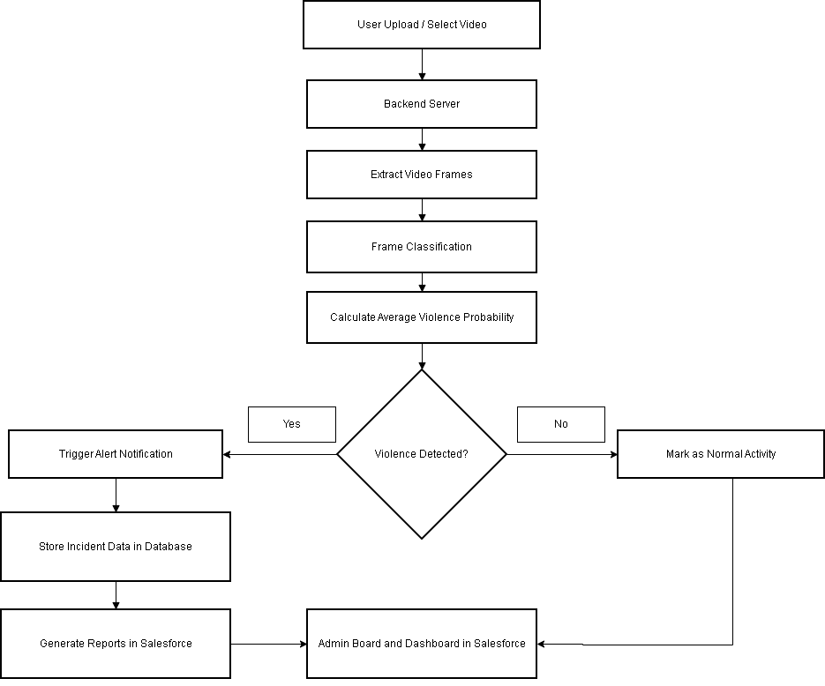
SYSTEM WORKFLOW

Slide 8
Module 1(Data Collection and Preparation):
Collect real-world violence and non-violence video datasets,RWF 200
Preprocess videos (frame extraction, resizing, normalization)
Label data into:
Violence
Non-Violence
Split dataset into training, validation, and testing sets
Module 2(Model Selection ,Training and Testing):
Select deep learning architecture (Vision Transformer / Hybrid Model)
Perform feature extraction from video frames
Train model using labeled dataset
Optimize using:
Loss function
Optimizer
Hyperparameter tuning
Evaluate model performance (Accuracy, Precision, Recall, F1-score)

Slide 9
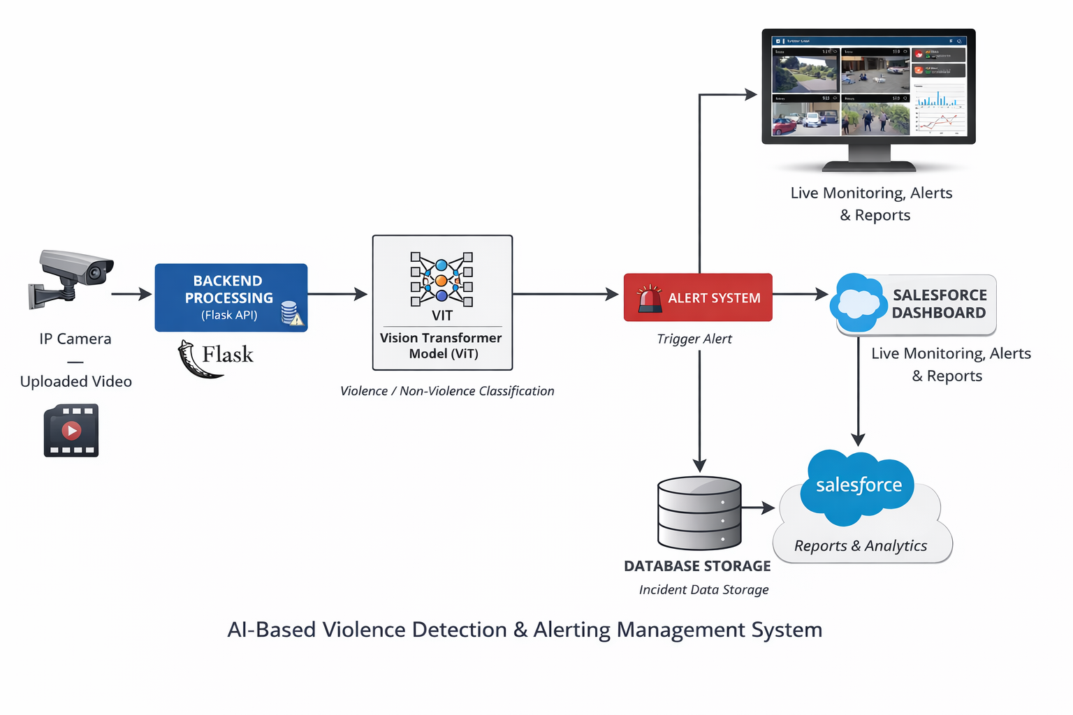
SYSTEM ARCHITECTURE

Slide 10
DATASET DETAILS
Dataset Composition:
Total Videos: 2000
Violence Videos: 1000
Non-Violence Videos: 1000
Dataset Source:
Publicly available violence detection datasets
Real Life Violence Data Set
Dataset Description
Dataset Type:
Video-based violence classification dataset
Binary classification: Violence / Non-Violence
Preprocessing:
Frame extraction from videos
Resize to 224 × 224
Normalization
Data Split:
Training Set: 70%
Validation Set: 15%
Testing Set: 15%

Slide 11
MODEL DETAILS
Model Architecture:
Vision Transformer (ViT) – Pre-trained model
Fine-tuned for binary classification
(Violence / Non-Violence)
Input Specifications:
Input size: 224 × 224 RGB images
Patch size: 16 × 16
Image divided into fixed-size patches
Positional embeddings added to patch embeddings
Training Configuration:
Loss Function: Binary Cross-Entropy Loss
Optimizer: Adam
Learning Rate: 0.0001
Batch Size: 16
Number of Epochs:10
Output:
Probability score for Violence / Non-Violence
Threshold-based classification

Slide 12
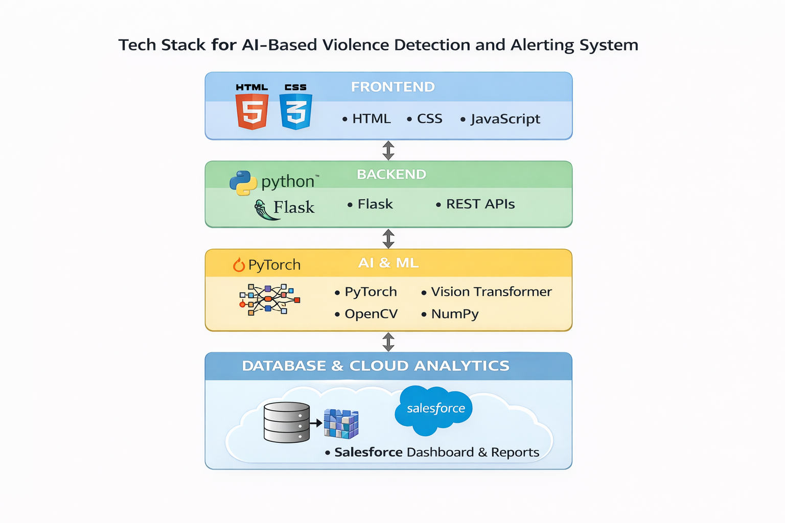
SOFTWARE REQUIREMENTS

Slide 13
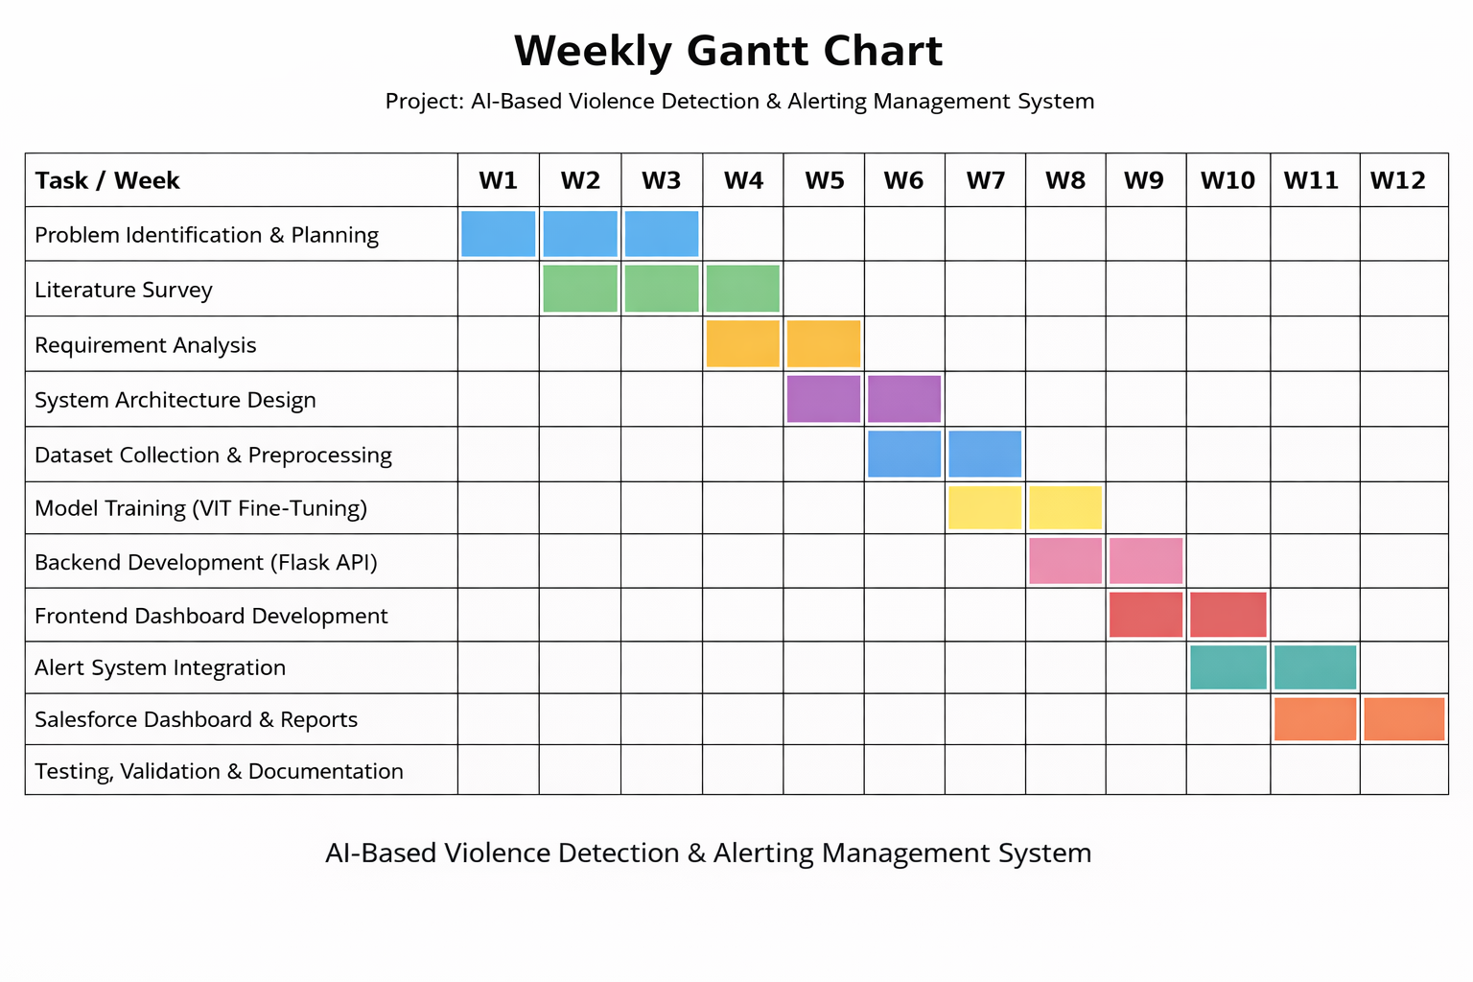

Slide 14
REFERENCE
[1] Mustaqeem Khan, Abdulmotaleb El Saddik, Wail Gueaieb, Giulia De Masi, Fakhri Karray,
“VD-Net: An Edge Vision-Based Surveillance System for Violence Detection”,
IEEE Access, Vol. 12, pp. 43796–43810, 2024.
[2] Animela Niharika, Konapalaneer Phani,
“Advanced Detection of Violence From Video Using Deep Learning Models”,
IEEE Access, Vol. 13, 2025.
[3] Hexuan Fan, Quigfeng Tan, Runnan Tan,
“Toward Fast and Accurate Violence Detection for Automated Video Surveillance Applications”,
IEEE Access, Vol. 11, 2023.

Slide 15
REFERENCE
[4] Saulo W. D. S. Costa, Yomara Pinheiro Pires, Ailton Lopes de Sousa, Fernando A. R. Costa, Euzébio de Oliveira, Fabiola Pantoja Araújo, Marcos Cesar da Rocha Seruffo,
“WHOT, a Novel Tool to Assist Women Victims of Violence: A Case Study in the Brazilian Amazon”,
IEEE Access, Vol. 9, pp. 95046–95057, 2021.
[5] Mustaqeem Khan et al.,
“Intelligent Edge-Cloud Based Surveillance Framework for Real-Time Violence Detection”,
IEEE Access, Vol. 12, 2024.

Slide 16
THANK YOU

